Slide 1
TRAVEL AND TOURISM MANAGEMENT SYSTEM
PRESENTED BY :-
NAFEES KAUSAR
0126CS193D01

Slide 2
INTRODUCTION
Travel and tourism management service is a web based application useful for managing different types of bookings from using a single application.
This system is basically concerned to provide a convenient way for a customer to book hotels, flight, train and bus for tour purposes.
The objective of this project is to develop a system that automates the processes and activities of a travel agency. In this project, I will make an easier task of searching places and for booking train, flight or bus.
The system is totally safe for online transactions and improves the overall user experience for your customers.

Slide 3
OBJECTIVE
To provide best travelling services to the customers.
To provide a search platform where a tourist can find their tour places according to their choices.
To promote responsible and interesting tourism so that people can enjoy their holidays at their favourable places.
To develop tourism with different cultures so that they enrich the tourism experience and build pride.
To create and promote forms of tourism that provide healthy interaction opportunities for tourists and locals and increase better understanding of different cultures, customs, lifestyles, traditional knowledge and believes.
To provide a better way to connect with various events.

Slide 4
MOTIVATION
The purpose of website is established fact that Internet users are increasing today. One of the main purposes of the website is to facilitate the offline customer into online because customers cannot spend their precious time in markets trying to find out the best deal.
For example – Many Students find difficulty in arranging the college tour. They face problems in getting a right package and correct destination.
Same happens to us while deciding our college tour. So, we have decided to make this website.

Slide 5
We have also find various problems in the existing system. Many websites has not introduced new mode of tourism like Medical Tourism and Educational Tourism.
So, we are introducing it in our website.

Slide 6
2.SYSTEM ANALYSIS
2.1.System Analysis
In This chapter, we will discuss and analyze about the developing process of FeesQuee Travel and Tourism Management System including software requirement specification (SRS) and comparison between existing and proposed system. The functional and non-functional requirements are included in SRS part to provide complete description and overview of system requirement before the developing process is carried out. Besides that, existing VS proposed provide a view of how the proposed system will be more efficient that the existing one.

Slide 7
2.2 Software Requirements Specification (SRS)
2.2.1 General Description
FeesQuee Travel and Tourism Management System is a computerized system which helps user to manage the daily booking activity in electronics format. It reduces the risk of paper-work such as file lost, file damaged and time consuming.
2.2.2 Problem Statement
The problem occurred before having computerized system includes:-

Slide 8
File Lost :
When computerized system is not implemented, file is always lost because of human environment. Sometimes due to some human errors, there may be a loss of records.
File is damaged when a computerized system is not there due to some accident like spilling of water. Besides some natural disaster like floods or fires may also damage the files.
Space Consuming :
After the number of records becomes large the space for physical storage of file and records also increase if no computerized system is implemented.
Cost Consuming :
As there is no computerized system then to add each record, paper will be needed which will increase the cost for the management of tourism.

Slide 9
2.3.System Objective
Improvement in control and performance :
The system is developed to cope up with the current issues and problems of tourism. The system can add user, validate user is also bug free.
Save Cost :
After computerized system is implemented, less human force will be required to maintain the tourism thus reducing the overall cost.
Save Time :
User is able to search tour package by using few clicks of mouse and few search keyboard thus saving his valuable time.
Tour Package Details :
Admin have a facility to upload information of tour package in a form of pics. File having size not more than 5 MB.

Slide 10
2.4.Existing VS Proposed System
Existing System
Generally people find difficulties in getting better treatment if they get ill during travelling and existing system doesnot provide medical facilities.
All the works are done manually.
In the manual system, the customer has to visit the travelling offices for booking.
In this system we first take the enquiry of the travelling and then finally book ticket by paying the required amount through cash.
It is laborious task to maintain the details of customers and the payment receipt in register.
The registered tour packages are written in the notebook.
The travelling facilities is limited to an area or persons.
The data stored in file is not save and can be stolen by anyone

Slide 11
Existing VS Proposed System
Proposed System
We have also take care of the health of traveller during their journey.
So, we have link our agency with different health center located in different cities.
Generally people find difficulties in getting better treatment if they get ill during travelling. So, by keeping this in our mind, we included MEDICAL TOURISM in our websites.
To create a web based application for the organisation.
The customer can easily search the holiday places that they want to visit.
It creates different types of reports.
This system provide the facility of online ticket booking and online payment facilities.
To provides package details, hotels details, transportation details, etc.
Customer has the facility to cancel their booking and 15% is deducted from their amount.

Slide 12
2.4.1.Additional Features :-
We have added a new features of Medical Tourism in our website to give the medical facility to tourist in case of emergency.

Slide 13
WHAT IS MEDICAL TOURISM
Medical Tourism is a tourism in which people travel to different countries for getting medical facility and to take advantages of the price and regulatory differences particularly in Southeast Asia, India, Eastern Europe, Cuba and Canada. This usually happened to those who lived in less-developed country where better treatment is not availables so they move to highly developed country for treatment which was unavailable at there home. Sometimes it also refers as people from developed countries travel to another country for lower price medical treatment.

Slide 14
The motive is also for getting medical services that are unavailable or illegal in their home country
Medical Tourism have created a lot of jobs in the field of medical science. Many doctors get employment in different hospitals according to their specialization.
Thus, we are including it in our website to provide medical facility to the traveller during their journey

Slide 15
2.5.System Requirements
2.5.1.Non-functional Requirements
EFFICIENCY REQUIREMENT :
When Apex Tour and Travel Management System will be implemented, staff and user will easily access website and searching tour package and successful transaction will be very faster.
RELIABILITY REQUIREMENT :
The system should accurately performs user registration, user validation, search and booking successful transaction.
USABILITY REQUIREMENT :
This system is designed for a user-friendly environment so that user and staff of apex travel can perform the various tasks easily and in an effective way.
.

Slide 16
IMPLEMENTATION REQUIREMENTS :
In implementation of whole system, it uses html in front-end with javaScript, Nodejs as server-side scripting language which will be used for database connectivity and the back end i.e. the database part is developed using SQL.
DELIVERY REQUIREMENT :
The whole system is expected to be delivered in six months of time with a weekly evaluation by the project guide

Slide 17
2.5.2 Functional Requirements
2.5.2.1 .Description of Features
This features used by the user to login into system. They are required to enter user id and password before they are allowed to enter the system. The user id and password will be verified and if invalid id is there, user is not allowed to enter the system.
Functional Requirement :
User id is provided when they register.
The system must only allow user with valid id and password to enter the system.
The system performs authorization process which decides what user level can access to.
The user must be able to logout after they finished using system.

Slide 18
2.5.2.2. Register New User
Description of Feature:
This feature can be performed by all users to register new user to create account.
Functional Requirement:
System must be able to verify information.
System must be able to delete information if information is wrong.

Slide 19
2.6.Software Requirement
Operating system :-
Windows 7 or higher version of windows is used as the operating system as it is stable and supports more features and is more user friendly.
Database MONGODB :-
MYSQL is used as database as it easy to maintain and retrieve records by simple queries which are in English language which are easy to understand and easy to write.
Development tools and Programming Languages :-
HTML is used to write the whole code and developed WebPages with CSS, JavaScript for styling work and NodeJS for server side scripting.

Slide 20
2.7.Hardware Requirement
Intel core 2nd generation is used as a processor because it is fast than other processors and provide reliable and stable and we can run our PC for long time. Processor may be 2.3 GHz or more. By using this processor we can keep on developing our project without any worries.
Ram 1 GB is used as it will provide fast reading and writing capabilities and will in turn support in processing.
HDD 50 GB Hard Disk space or above.

Slide 21
Methodology
WEB APPLICATION
FRONTEND
BACKEND
API
HTML
CSS
BOOTSTRAP
JAVASCRIPT
JQUERY
AJAX
React JS
Node.js
PHP
Google Map API
Google Weather API

Slide 22
Progress
Studying the existing system.
Analyse different websites for eg- yatra.com, makemytrip.com
Learning the languages that will be used in making this project.
Designing the layout for this project.
Here are some examples of my project describing what I want to build and what it would look like.

Slide 23
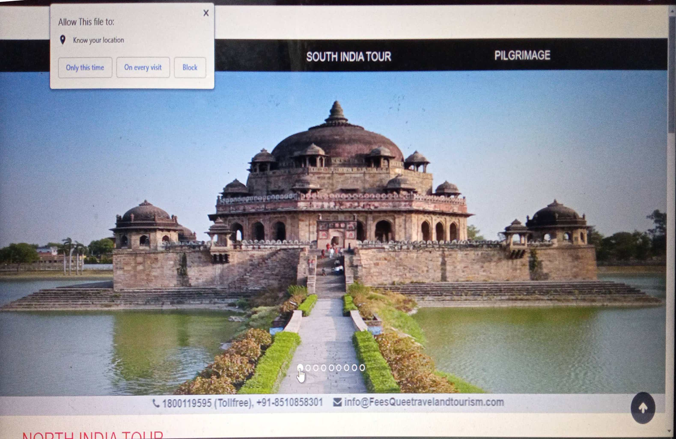

Slide 24
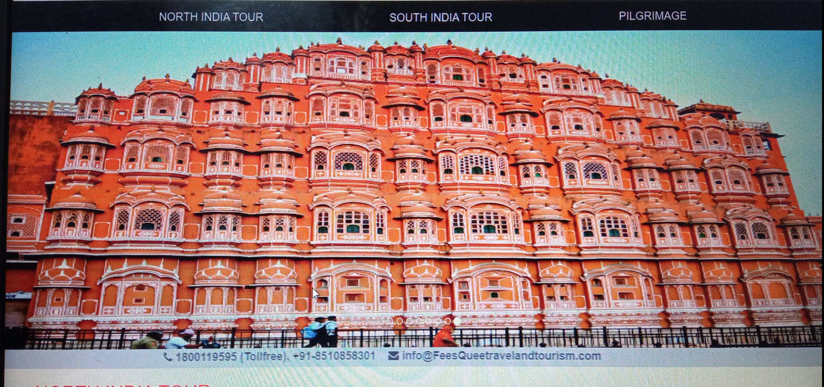

Slide 25
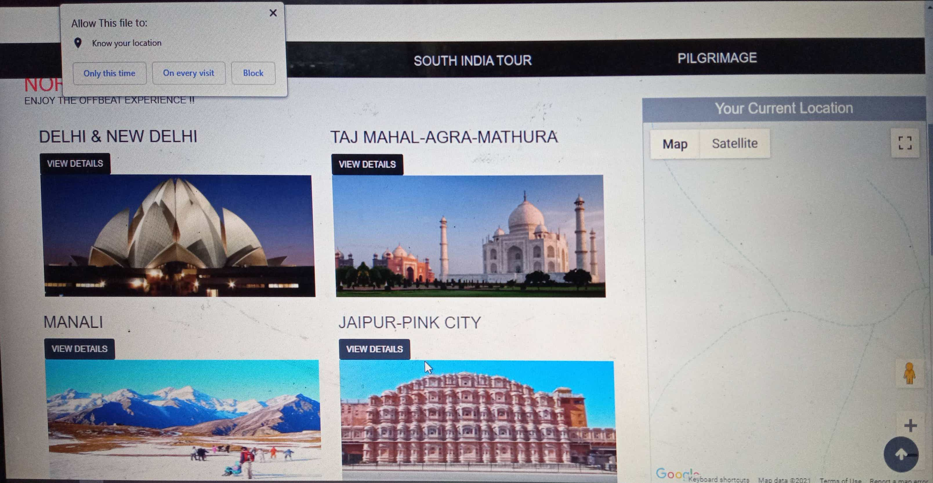

Slide 26
Upcoming Targets
Coding of Project.
Add graphics.
Make the website responsive to access on any devices.
Making various database table for information storage.
To add new feature of generating a Pdf after successful transaction and the ticket will be downloaded automatically in Pdf form.
This will be achieved by using a JavaScript library called jsPDF.
Launch this website.

Slide 27
Thank You

